Slide 1

KIET GROUP OF INSTITUTIONS, GHAZIABAD
DEPARTMENT OF COMPUTER SCIENCE
“INDIEWORKS”
E-COMMERCE FOR ARTISANS
PROJECT ID: PCS25-21
PRESENTED BY:
NIKHIL GARG GUIDE:
PRAKHAR SHARMA DR HARSH KHATTER
NAVNEET SAINI
DIWAKAR MITTAL

Slide 2
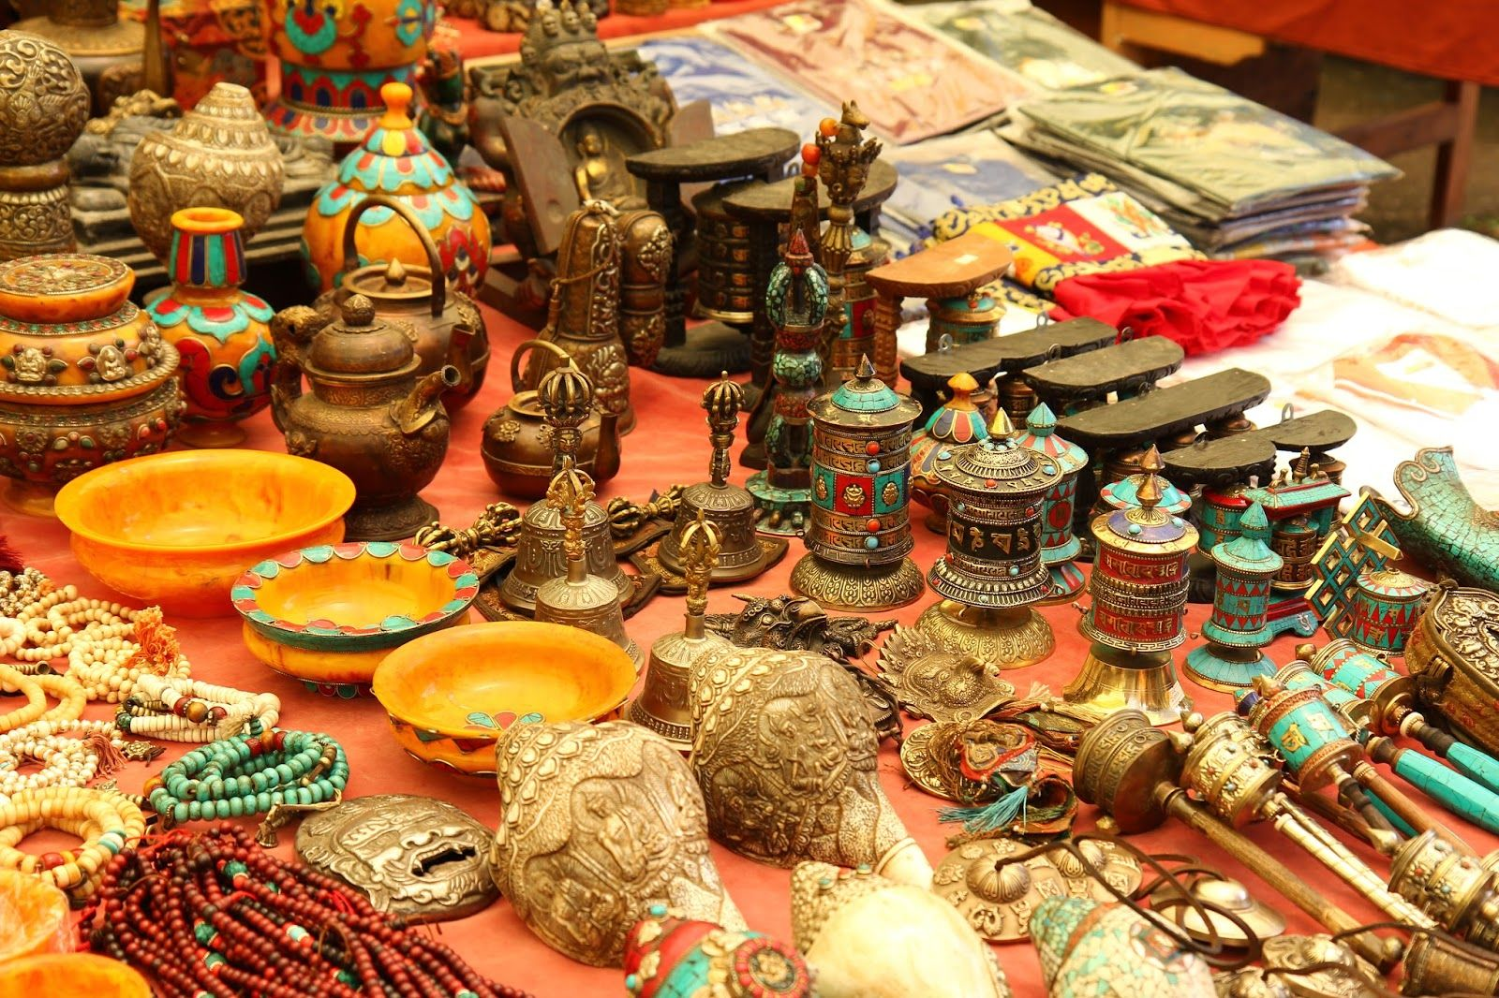
PROBLEM STATEMENT
Traditional artisans face significant challenges in reaching a global audience
Artisans encounter barriers related to limited market exposure, complex transaction processes, and insufficient technological infrastructure
Lack of a centralized hub for traditional craftsmanship causes underrepresentation of these skilled artisans

Slide 3
PROJECT IMPORTANCE
Ecommerce: one of the largest factors of economic growth
Handicraft reflects the culture and skill of the country.
India: The biggest market for handicraft
IndieWorks: Provides a platform to artisans to sell their products

Slide 4
OBJECTIVES
Empower artisans by giving them a dedicated space to reach a broader audience.
Facilitate the buying and selling of unique
User-friendly platform :supports seamless transactions and promotes artisanal craftsmanship

Slide 5
SCOPE
PROJECT IMPORTANCE
Artisian Onboarding: User-friendly registration process for artisans to join the platform
Product Management: System for artisans to add, edit, and remove products easily
E-Commerce Functionality: Integrate secure payment gateways for seamless transactions
Search and Filters: Search functionality and filters to help users find specific artisan products
Shipping and Logistics: Integrate shipping options and provide tracking features
Customer Support: Provide a customer support system for inquiries, complaints, or assistance
Ecommerce: one of the largest factors of economic growth
Handicraft reflects the culture and skill of the country.
India: The biggest market for handicraft
IndieWorks: Provides a platform to artisans to sell their products

Slide 6




TIMELINE

Slide 7
TIMELINE

Slide 8
TIMELINE

Slide 9
TIMELINE

Slide 10







Slide 13


Slide 14


Slide 16

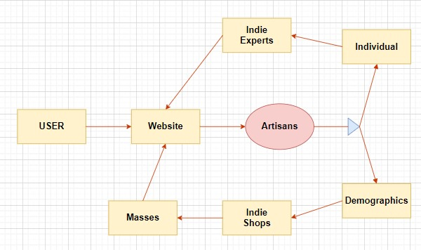

Slide 17
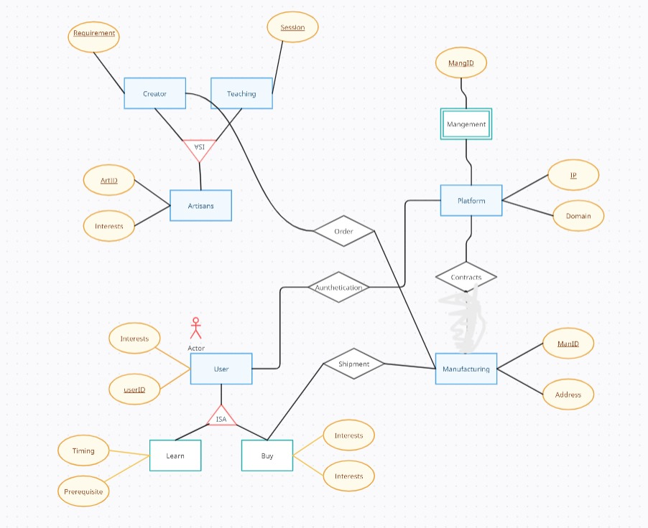
ER DIAGRAM

Slide 18

E-Commerce 202X: The Essential Guide to Online Business" by Rob Thomas
The Lean Startup: How Today's Entrepreneurs Use Continuous Innovation to Create Radically Successful Businesses" by Eric Ries
E-Commerce Get It Right!: Essential Step-by-Step Guide for Selling & Marketing Products Online" by Ian Daniel
The Handmade Marketplace: How to Sell Your Crafts Locally, Globally, and Online" by Kari Chapin
Etsy-preneurship: Everything You Need to Know to Turn Your Handmade Hobby into a Thriving Business" by Jason Malinak

Slide 19

Wrapping up our project journey, key aspects of our project:
Empowering Artisans
Bridging Gaps Through Technology
Fostering Trust and Transparency
Sustainable Growth
Future Prospects

